Slide 1
Statistical Bias and Feature Importance - AWS Data Wrangler and Sagemaker Clarify

Slide 2
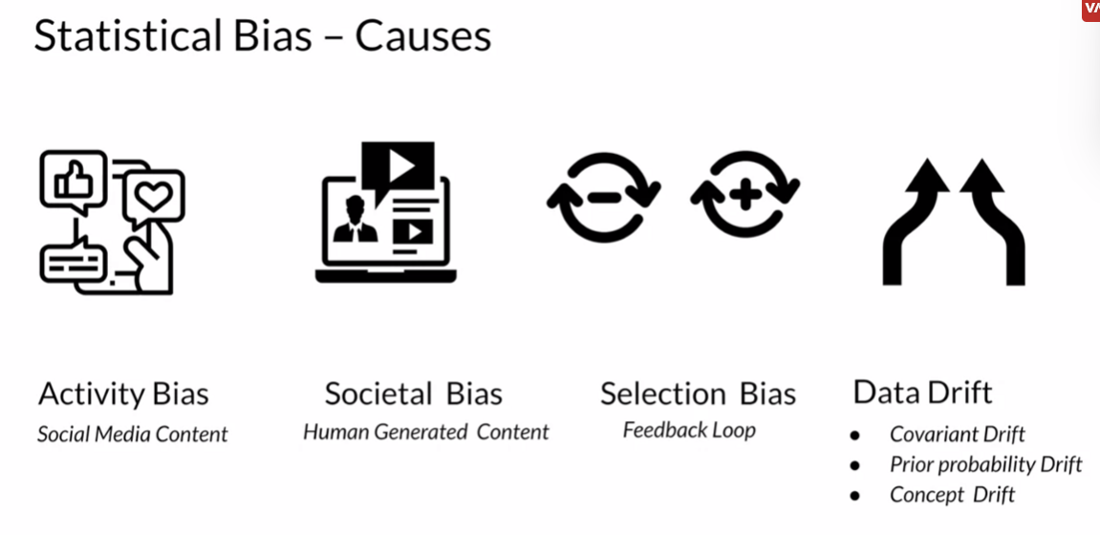
Statistical Bias
Statistical bias refers to the presence of imbalances or unfairness in datasets, which can lead to inaccurate or unfair model predictions. It can lead to models that favor certain groups or exhibit inaccurate generalizations. For instance, a biased model might provide less accurate predictions for underrepresented groups.
To address bias, it's crucial to identify it first. This involves analyzing the dataset to detect any disparities in data distribution, particularly in terms of attributes like gender, race, age, or any other sensitive feature.
Once bias is identified and quantified, strategies can be implemented to mitigate it. This might involve re-sampling the data, re-weighting instances, or using specialized algorithms designed for fairness.

Slide 3
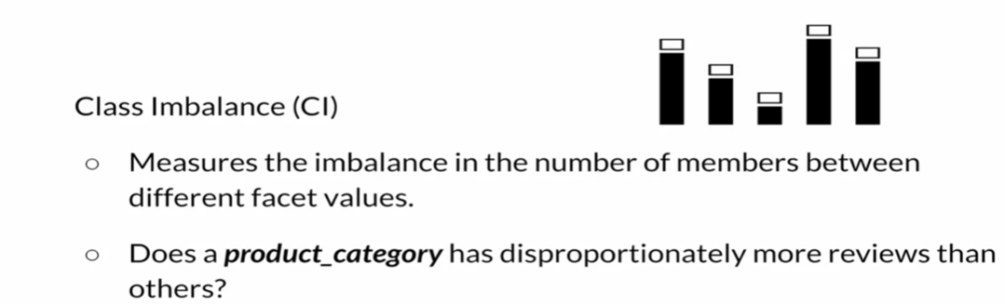
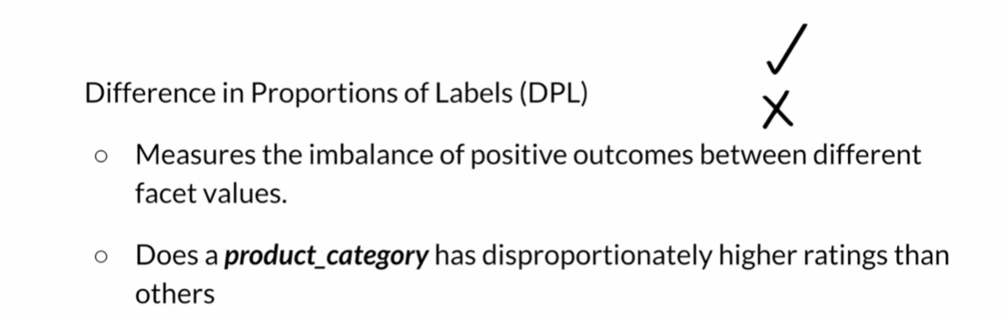
Measuring Statistical Bias

Slide 4
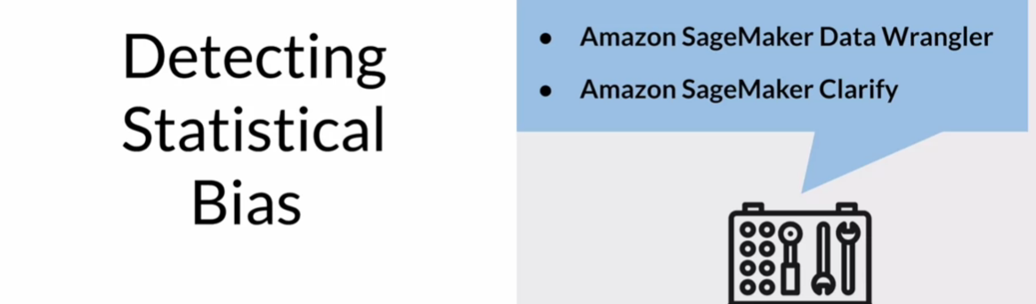
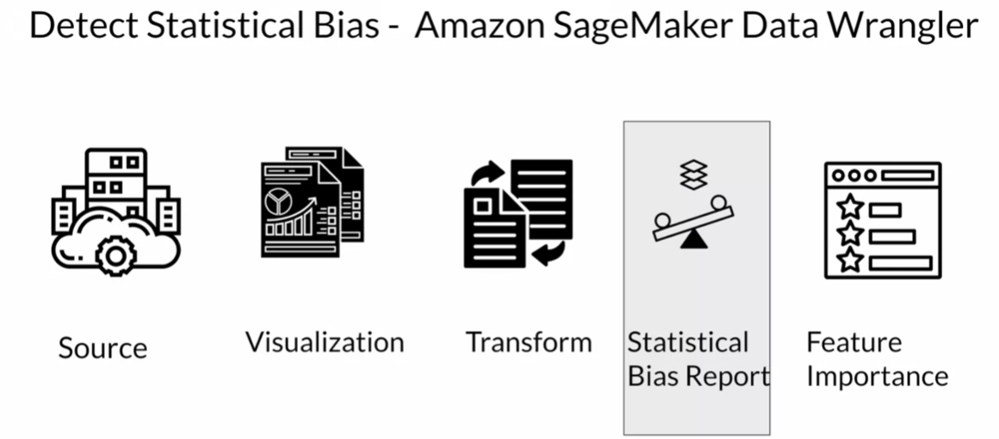
Detecting Statistical Bias

Slide 5
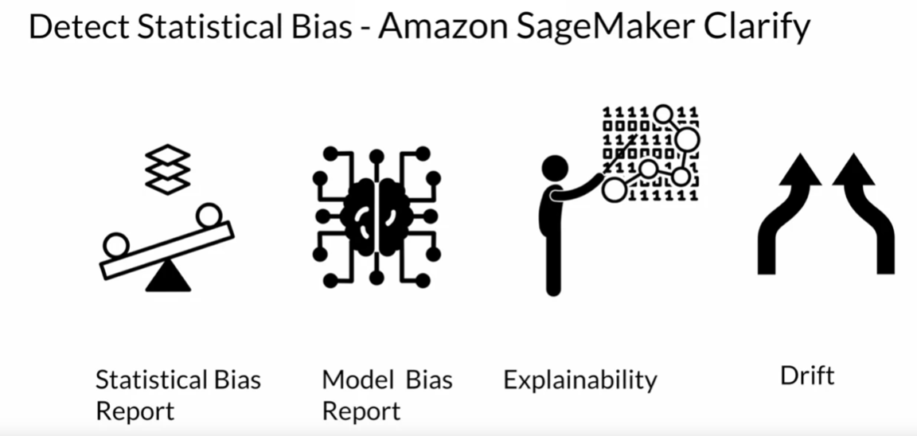
Detecting Statistical Bias
Amazon SageMaker Clarify is a tool that detects statistical bias in datasets and models, generating bias reports for fairness assessment. It can also identify bias in trained and deployed machine learning models.
Beyond bias detection, it offers Machine Learning explainability to clarify model decision-making. It also helps in monitoring Data and Model Drift.

Slide 6
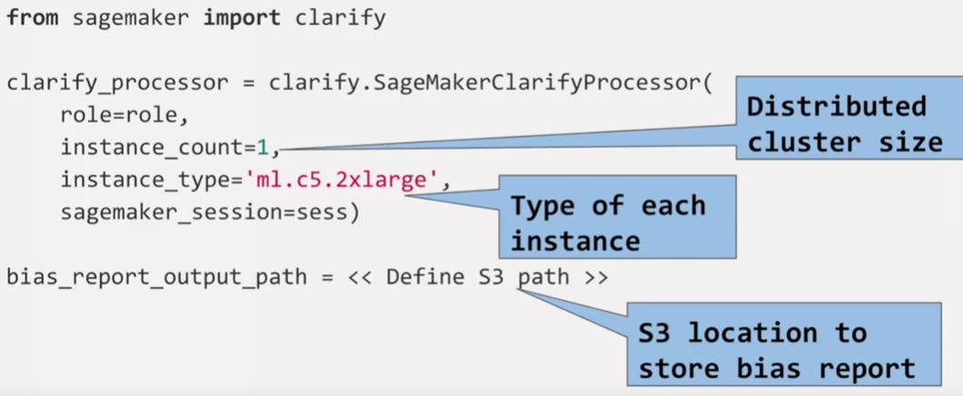
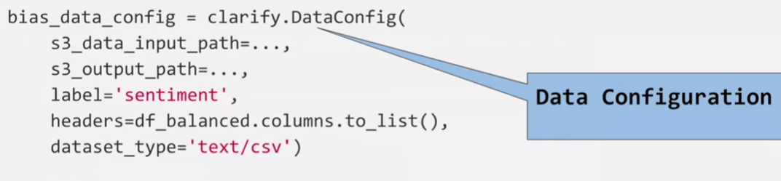
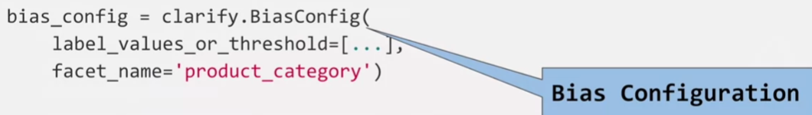
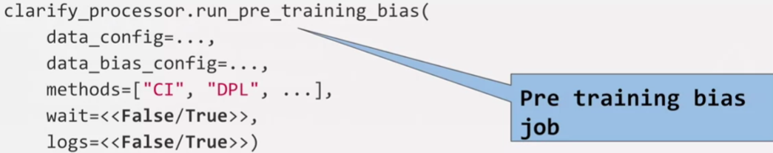
Detecting Statistical Bias

Slide 7
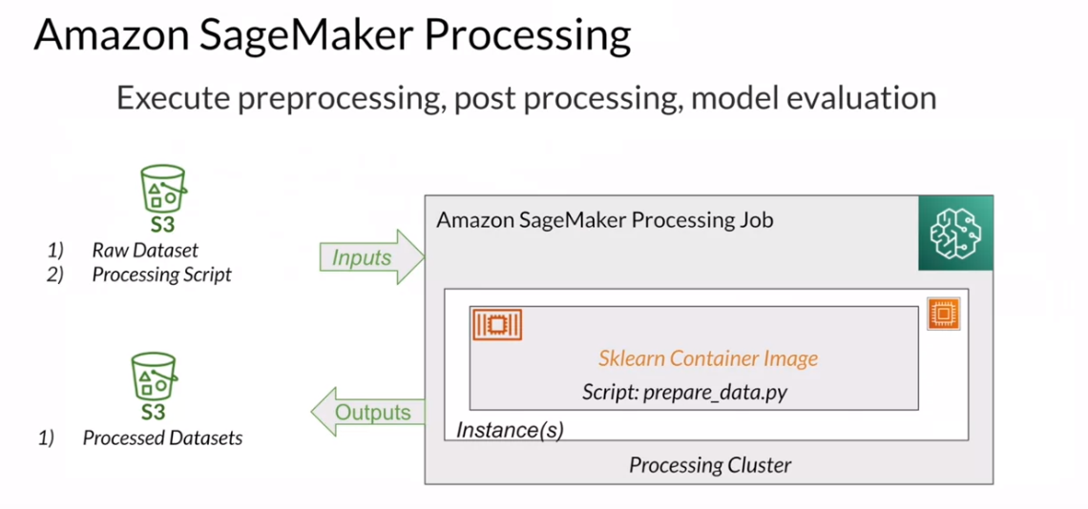
Detecting Statistical Bias

Slide 8
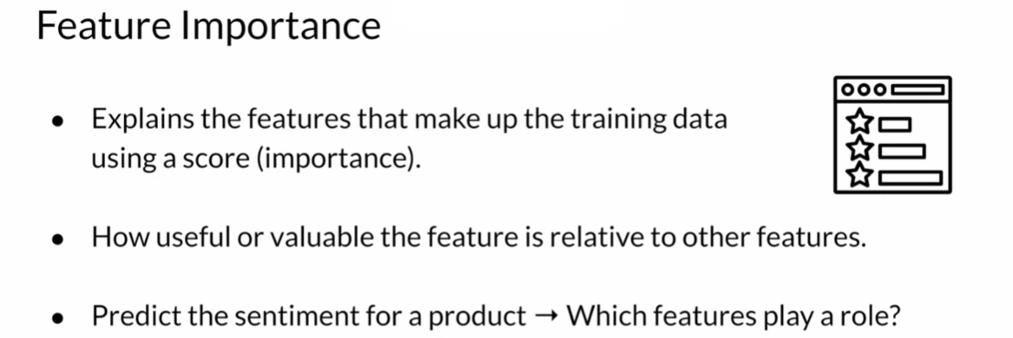
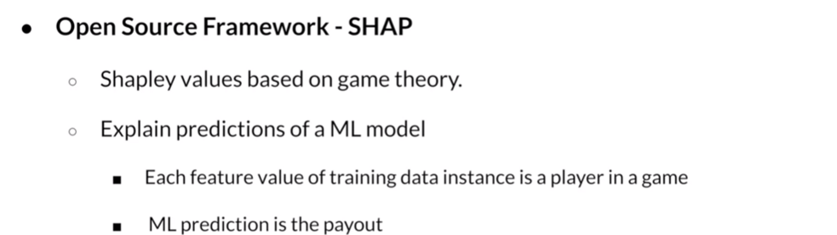
AWS Data Wrangler > New Data Flow > S3 Bucket > + > Quick Model

